Slide 1


Slide 2


FitFlex: Your Personalized Fitness Journey
FitFlex is an innovative fitness application designed to tailor your workout experience. With personalized fitness plans, nutrition tracking, progress monitoring, and community support, FitFlex aims to help users efficiently reach their fitness goals. Whether you're an experienced athlete or just starting your journey, FitFlex adapts to your needs and empowers you to stay motivated along the way.

Slide 3






Personalized Workout Plans
FitFlex aims to enhance the workout experience by offering tailored programs, a variety of activities, and adaptive adjustments to keep users motivated and progressing toward their fitness goals.
1
2
3
Tailored Programs
Variety of Activities
Adaptive Adjustments
FitFlex creates customized workout routines based on individual fitness levels, preferences, and goals.
The app offers a wide range of exercises, including strength training, cardio, yoga, and more.
As users progress, FitFlex adapts their plans to ensure continuous improvement and prevent plateaus.

Slide 4




Nutrition Tracking
2
Personalized Meal Plans
Suggested plans tailored to fitness goals.
Comprehensive Food Database
1
A vast database to log meals effectively.
Healthy Recipe Suggestions
Array of recipes to inspire nutritious choices.
3

Slide 5
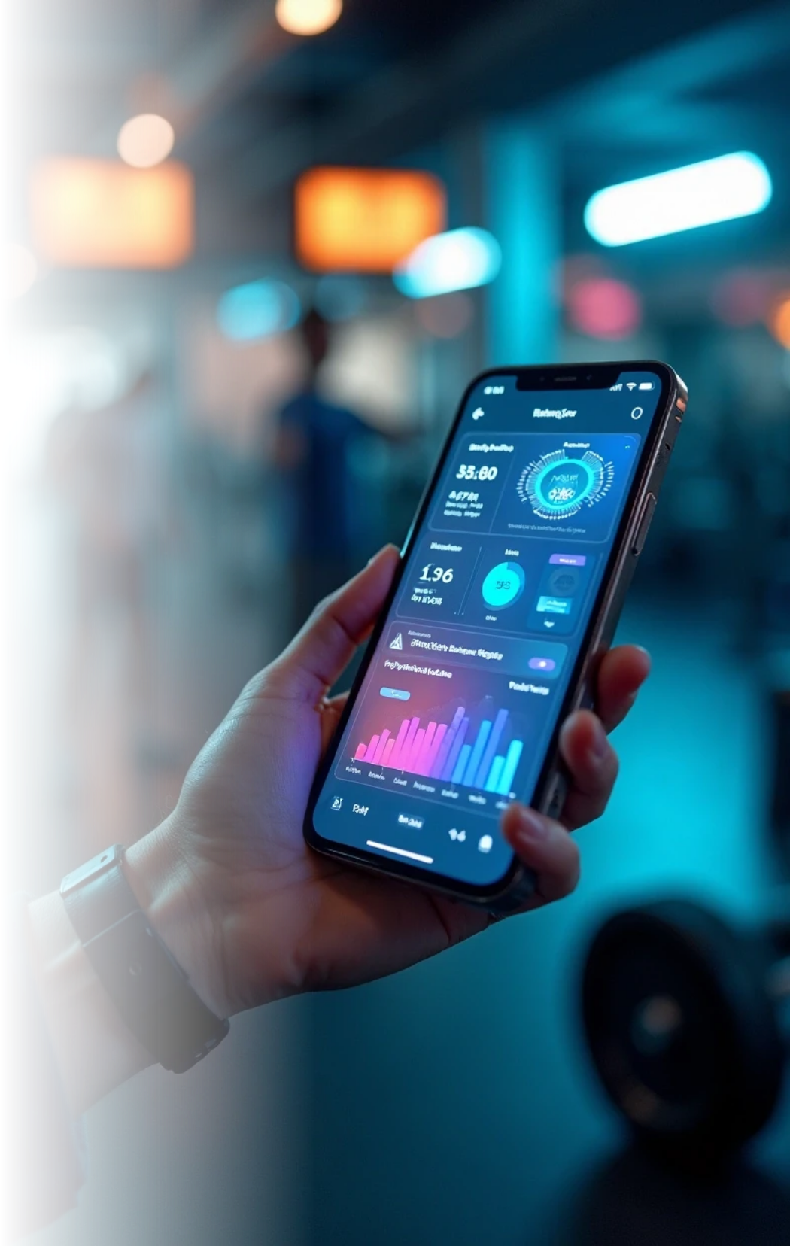

Progress Monitoring
Visual Analytics
FitFlex offers visual insights into users' fitness progress through easy-to-read graphs and charts.
Goal Setting & Achievements
Users can set specific fitness goals and track their achievements, receiving motivation and rewards.
Feedback Mechanism
The app allows users to receive constructive feedback on their workout performance.

Slide 6


Community Support
Social Features
Users can connect, share progress, and motivate each other.
Challenges and Competitions
Regular fitness challenges foster accountability and fun.
Expert Forums
Access forums with fitness experts for guidance and advice.

Slide 7



Integration with Devices
Heart Rate Monitoring
Users can track their heart rate during workouts to ensure optimal performance.
Wearable Device Compatibility
Sleep and Recovery Tracking
FitFlex seamlessly integrates with popular fitness trackers and smartwatches.
The app emphasizes the importance of rest in the overall fitness journey.
2
1
3

Slide 8


User Experience
Intuitive Interface
Custom Notifications
User Reviews & Feedback
FitFlex features an easy-to-navigate interface designed for users of all technical skill levels. Users can quickly find workouts, track meals, and monitor progress with minimal hassle.
Users can opt for personalized reminders for workouts, meals, and hydration, helping them stay on track without feeling overwhelmed.
The app encourages users to share their experiences and testimonials, fostering a sense of community and aiding new users in finding effective programs.

Slide 9

Future Developments in FitFlex
AI Personal Trainer
Expanded Community Features
Enhanced Customization Options
FitFlex plans to implement AI-driven features that will offer real-time feedback and virtual coaching to enhance user experience and workout effectiveness.
Future updates will include more community engagement tools, such as forums for sharing nutrition tips and group challenges tailored to diverse fitness levels.
The development team is focused on adding more customization options for workouts and meal plans to cater to evolving fitness trends and user feedback.

Slide 10


